Slide 1


Capstone Project Phase A
Project code: 23-1-D-6
Using speech recognition
to execute full website functionality
Project Supervisor: Mr. Alexander Keselman
Students: Michael Ravich, Tal Derai

Slide 2
Introduction – STT
Speech recognition to text (STT) is the ability of machine to identify words and phrases in spoken language and convert them into text.
First, the model takes in an audio as input (could be live speech).
The model pre-processes the audio to extract relevant features that can be used for transcription.
The extracted features are fed into a ML model.
The output of the ML model processed to generate a written transcript of the spoken words.

Slide 3
Pros and cons of Speech Recognition
Improved client care
Transcription errors
Increases productivity
Training period for software adaptation
PROS
CONS
Saves time and efforts
Difficult to build a perfect system
Useful for people who cannot use a keyboard
Slower throughput then with typing
Useful when the user’s hands are occupied
Difficult to use is noisy environment

Slide 4
Motivation
Voice is the future
Website accessibility for people with disabilities
Advanced technology for a contemporary needs
Improved comfort for speech recognition

Slide 5
Our Solution:
Our idea is to develop a mobile web service, which will be based on an existing model of artificial intelligence for speech recognition (Google speech-to-text API).
The purpose is to create an external component named “SpeakEasy” suitable to any website, in order to control all the functionality that the website offers by speech commands.
Also, “SpeakEasy” will allow transcription of the voice input into text for filling forms.

Slide 6
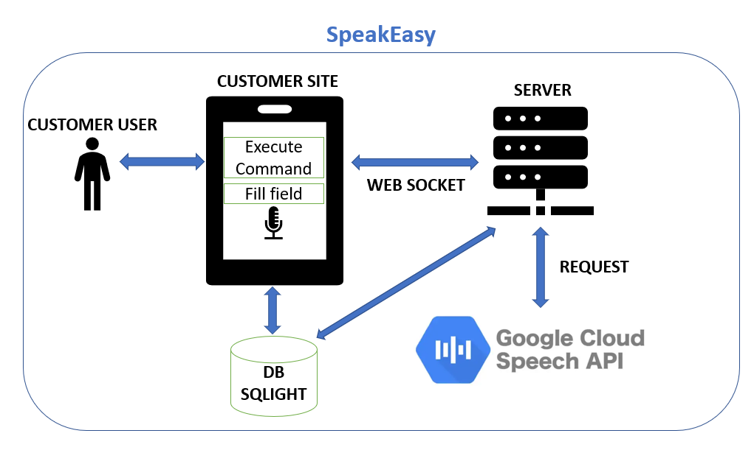
Architecture

Slide 7
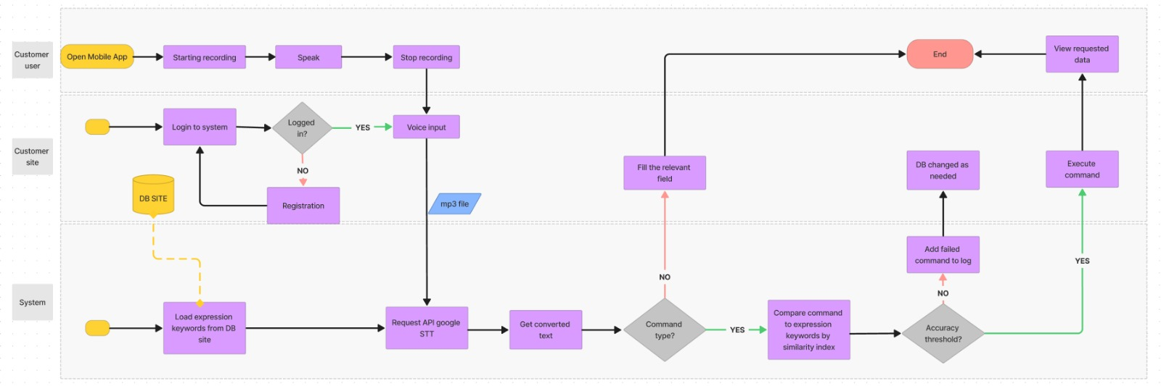
Activity Diagram

Slide 8
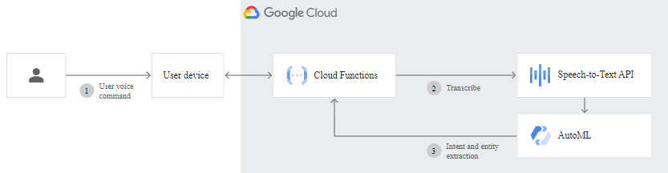
Google STT API
Google Speech-to-Text is a cloud-based API that enables developers to convert spoken words to written text using machine learning.
It is part of the Google Cloud Platform and can be accessed through a variety of methods, including through a web-based interface.
The API is based on machine learning algorithms that are trained to recognize and transcribe speech patterns in various languages.

Slide 9
Similarity Index
Similarity index is a measure of the similarity between two texts or documents.
There are several different ways to calculate similarity index (e.g: Cosine, Jaccard, LCS, etc..), but they generally involve comparing the content of the texts and determining the percentage of overlap or commonality.
e.g:
Speech input | Similarity (%)
Speech0.mp3 | 86.1
Speech1.mp3 | 88.4
Speech2.mp3 | 81.9
Speech3.mp3 | 69.61

Slide 10

Documenting the failed commands
In order to improve our system from time to time, we will record all commands that didn’t pass the threshold, so that the customer site can add relevant commands if necessary.
e.g:
* (threshold is 70%)
Failed command | Similarity percentage (%)
Show me all action movies in Haifa | 65
Project very interesting | 22

Slide 11
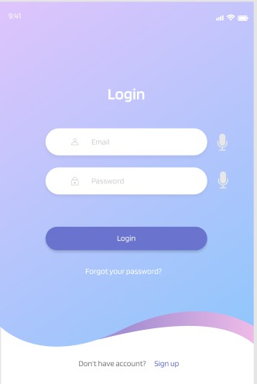
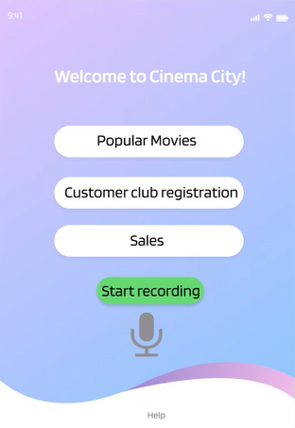
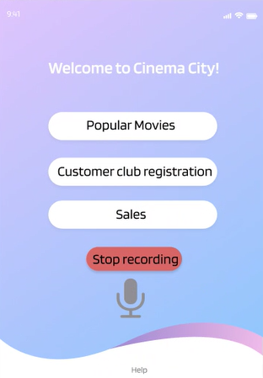

GUI
“Show me all action movies in Haifa”

Slide 12
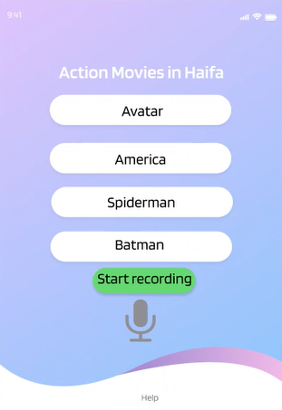
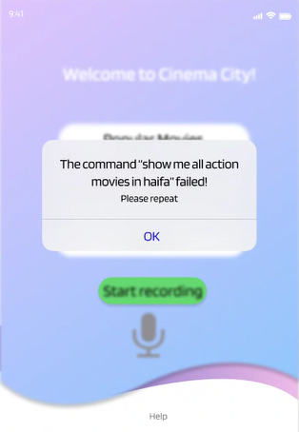
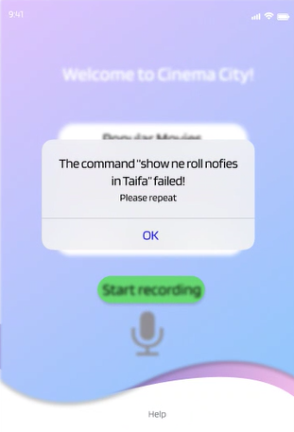
Optional Results
(1)
(2)
(3)

Slide 13
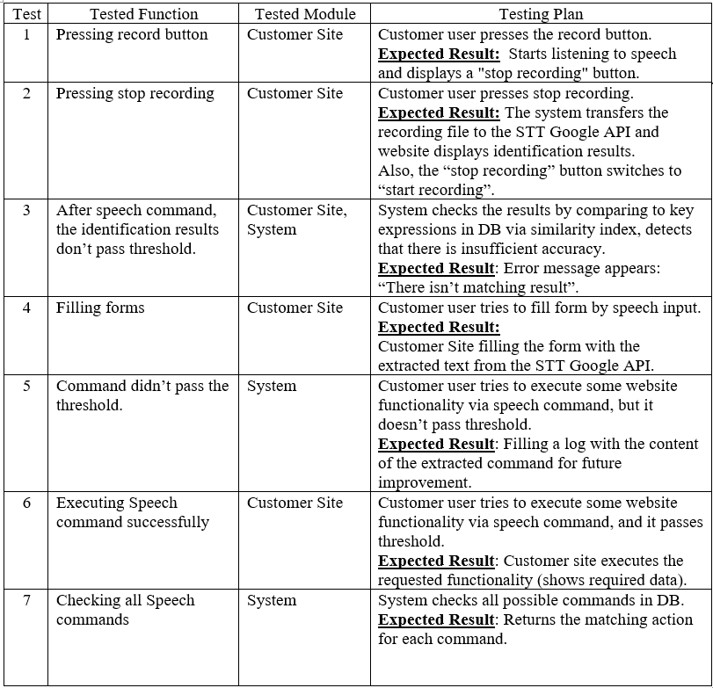
Verification Plan

Slide 14
Thanks for listening!
Any questions ?

